Slide 1
Remote Procedure Calls
By Nick Thomas

Slide 2
RPC
Short for Remote Procedure Calls
When a program causes a procedure/subroutine to be executed in a different address space.
Commonly a separate computer on the network
Can also be another program on the same computer

Slide 3
How do we make and call RPC’s?
There are no standards on how to write or call RPC’s
Some RPC’s can be called by marshalling the data from one program, through the OS to another and back again.
Others can be called by sending simple text strings or byte arrays.
This is what we will be doing, as its easier and works better over the network.
FYI: my solution is meant for demonstration purposes, it is not as robust as pre written liberties like:
Java Remote Method Invocation (Java RMI)
Modula-2’s network objects.
RPyC
Google Protocol buffers
Microsoft .NET Remoting

Slide 4
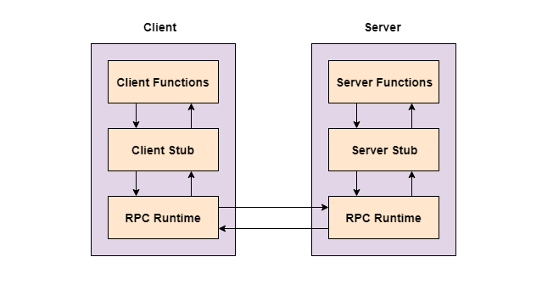

Slide 5
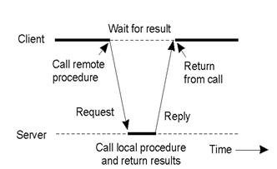
RPC’s are usually synchronous (IE, blocking)

Slide 6
Pros
Supports Process orientated and thread orientated models.
Message passing mechanism is usually hidden from users.
RPC can be used in distributed systems

Slide 7
Cons
Programmers might not be aware of which procedures are local and which are slow, remote procedures.
Can result in confusion and unpredictable systems.
Can add extra complexity to debug.
Can result in unmaintainable, spaghetti, code.

Slide 8
Advice
Make sure its obvious which function calls are local and which are remote
(I haven't done this, just so you can see how annoying it can be)
Document your system
Handle error cases
What do we do if we receive gibberish from the server?
What do we do if the server is uncontactable?

Slide 9
How our system will work
Data
Code
Code
Data
Byte array
Byte array
Data
Code
TCP/IP
Code
Data
Code
Code
Data
Data
Our RPC Code

Slide 10
Questions?

